Slide 1

Forecasting Individuals' Uptake Of H1N1 And Seasonal Flu Vaccines
PHASE 3 PROJET
By Cleve Mwebi

Slide 2






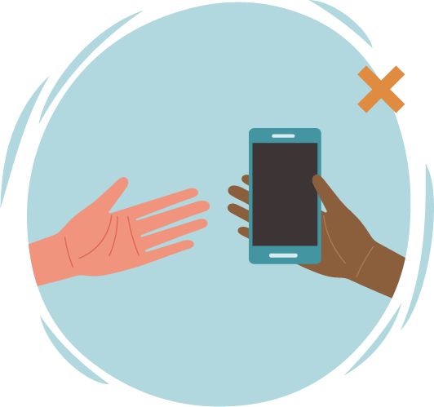

Table of Contents
Overview
Problem & Data Understanding
Modeling
Evaluation
Conclusion
Recommendation
Next Steps
​Thank You

Slide 3

Overview
Recent global health challenges include major pandemics like H1N1 and COVID-19, alongside outbreaks like Zika and Ebola, profoundly impacting public health.
Understanding these pandemics, marked by shared viral characteristics, is key to grasping how individual behaviors influence vaccine choices.
Historical data analysis offers insights for personalized public health strategies and predicting future vaccination trends.
This knowledge aids in resource distribution, stakeholder engagement, and refining pandemic response tactics.

Slide 4
Problem:
Predict whether people received H1N1 and seasonal flu vaccines during 2009 H1N1 pandemic
Important to understand drivers of vaccine decisions to improve public health strategies
This analysis intends to identify key factors that influenced if someone got vaccinated
World Health Organization is stakeholder seeking insights to enhance vaccine uptake

Slide 5
Data Overview:
Dataset is from survey of over 26,000 people during 2009 H1N1 flu pandemic
Captures attitudes, knowledge, behaviors related to H1N1 and seasonal flu
Indicates through labels whether each person received H1N1 and/or seasonal vaccine
Rich dataset enabling analysis of patterns influencing vaccine choices

Slide 6
Analysis Approach:
Explore distributions and relationships in survey data to uncover insights
Prepare data for modeling through encoding, addressing missing vals, scaling
Build classification models to predict likelihood of H1N1 and seasonal vaccine uptake
Assess accuracy of predictions to determine effective modeling techniques

Slide 7
Modeling: Prediction Models
Used 3 main types of models to predict likelihood of vaccine uptake - Logistic Regression, Random Forest, and Gradient Boosting
Logistic Regression calculates probability of vaccine uptake based on survey data
Random Forest constructs a "forest" of decision trees trained on sections of data to make predictions
Gradient Boosting sequentially develops an ensemble model, each new predictor improving on deficiencies of the previous one

Slide 8
Modeling: Preparing Models
Split dataset into training and validation subsets to test model performance
Handled imbalanced classes where few vaccine recipients relative to non-recipients
Scaled numerical data like income and normalized units for model compatibility
Encoded text responses as binary categories for model interpretation

Slide 9
Evaluation: Evaluation Metrics
Accuracy - percentage of correct vaccine uptake predictions overall
Precision - for those predicted to get vaccine, how many actually did
Recall - out of all who got vaccine, how many did model correctly predict
F1-score - balance between precision and recall for a class
ROC AUC - separation measure between recipients and non-recipients

Slide 10
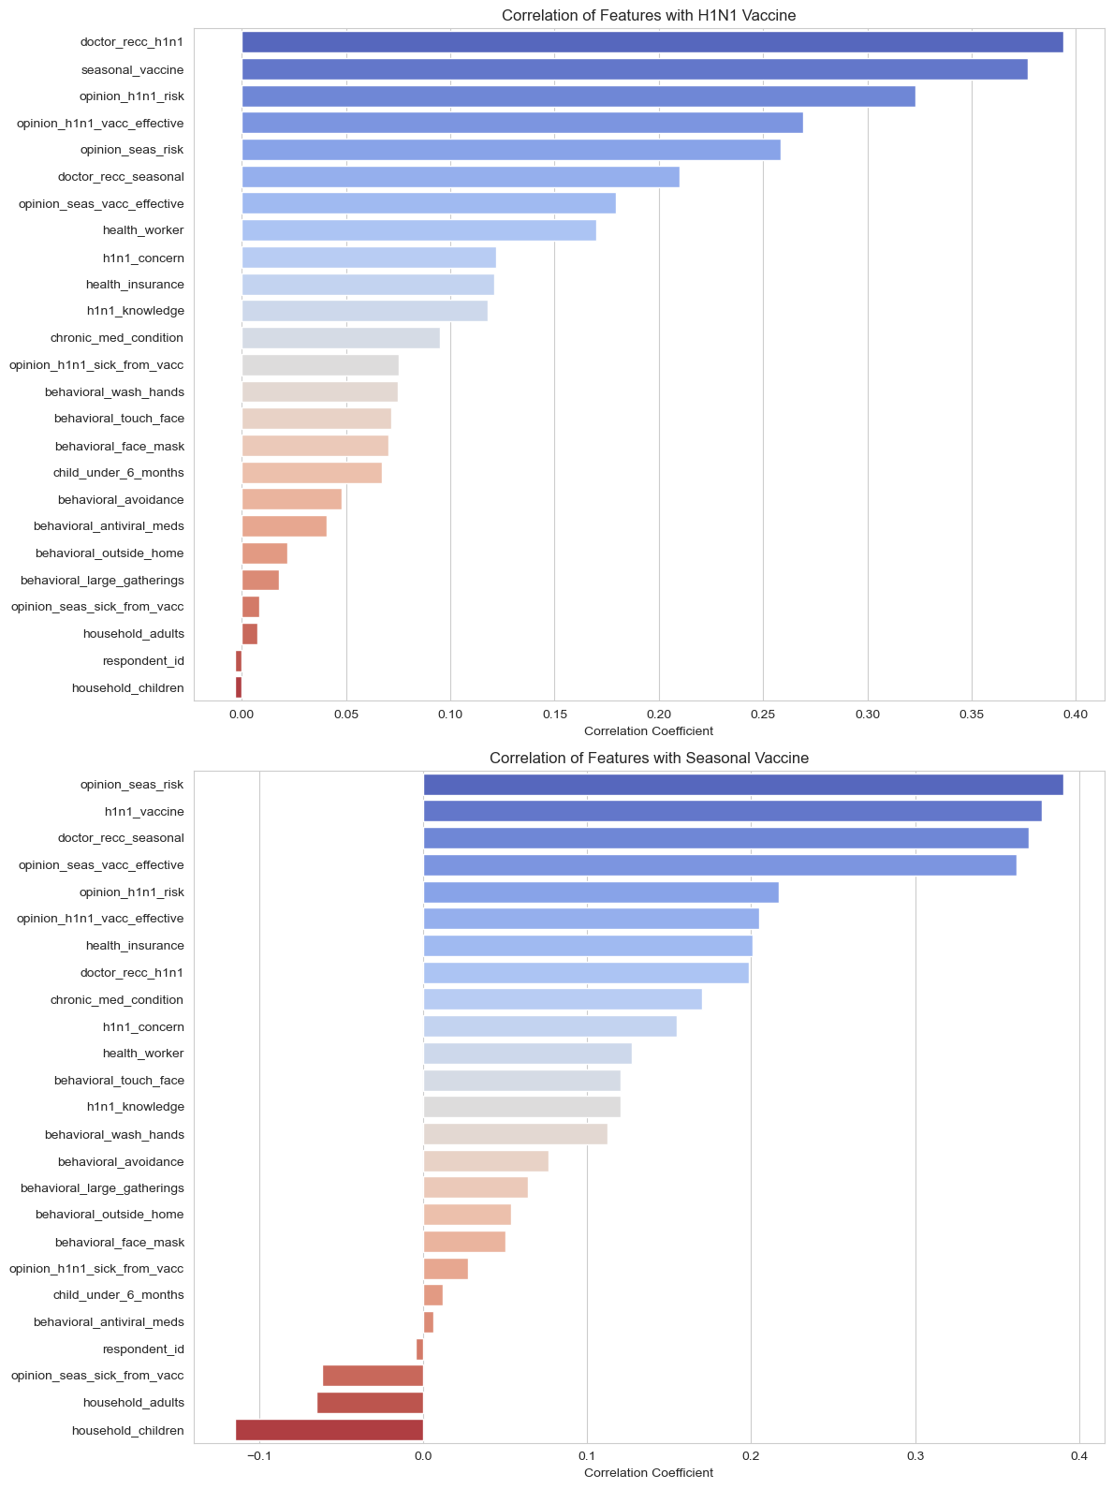
Correlation of Features For the 2 Vaccines

Slide 11
Evaluation: Model Performance
Accuracy highest in Gradient Boosting and Random Forest for H1N1 vaccine
Logistic Regression best at detecting true vaccine recipients (recall)
Random Forest most precise in predicting those not vaccinated
For seasonal vaccine, Logistic Regression and Random Forest had best balance
All models showed good discrimination between vaccinated and unvaccinated groups

Slide 12
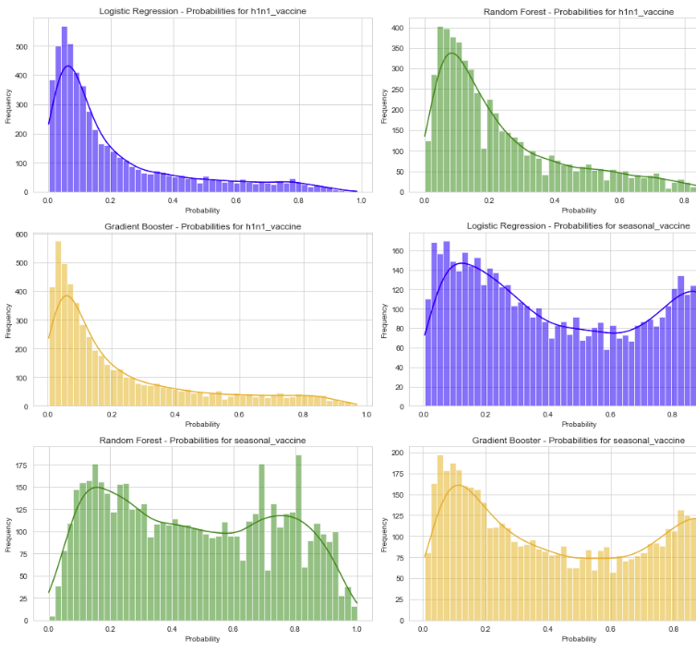
Performance of Different Models

Slide 13
Recommendations
Improve public education on vaccines, especially for groups with less awareness or inaccurate beliefs
Direct customized vaccine campaigns and affordable services towards communities with lower uptake rates based on poverty, education level or race
Expand health insurance coverage which could indirectly increase vaccine acceptance
Ensure vaccine access, information and awareness reaches all groups equally, regardless of demographics

Slide 14
Next Step
Expand data collection through additional survey administrations to validate findings and monitor ongoing trends
Gather supplementary datasets encompassing wider demographic and psychosocial attributes to build more comprehensive predictive models
Conduct stratified analyses focused on population subgroups to uncover specialized insights related to education, income, race, etc.
Implement integrated qualitative and quantitative investigations to acquire richer perspectives on attitudes, beliefs, behaviors surrounding vaccines

Slide 15
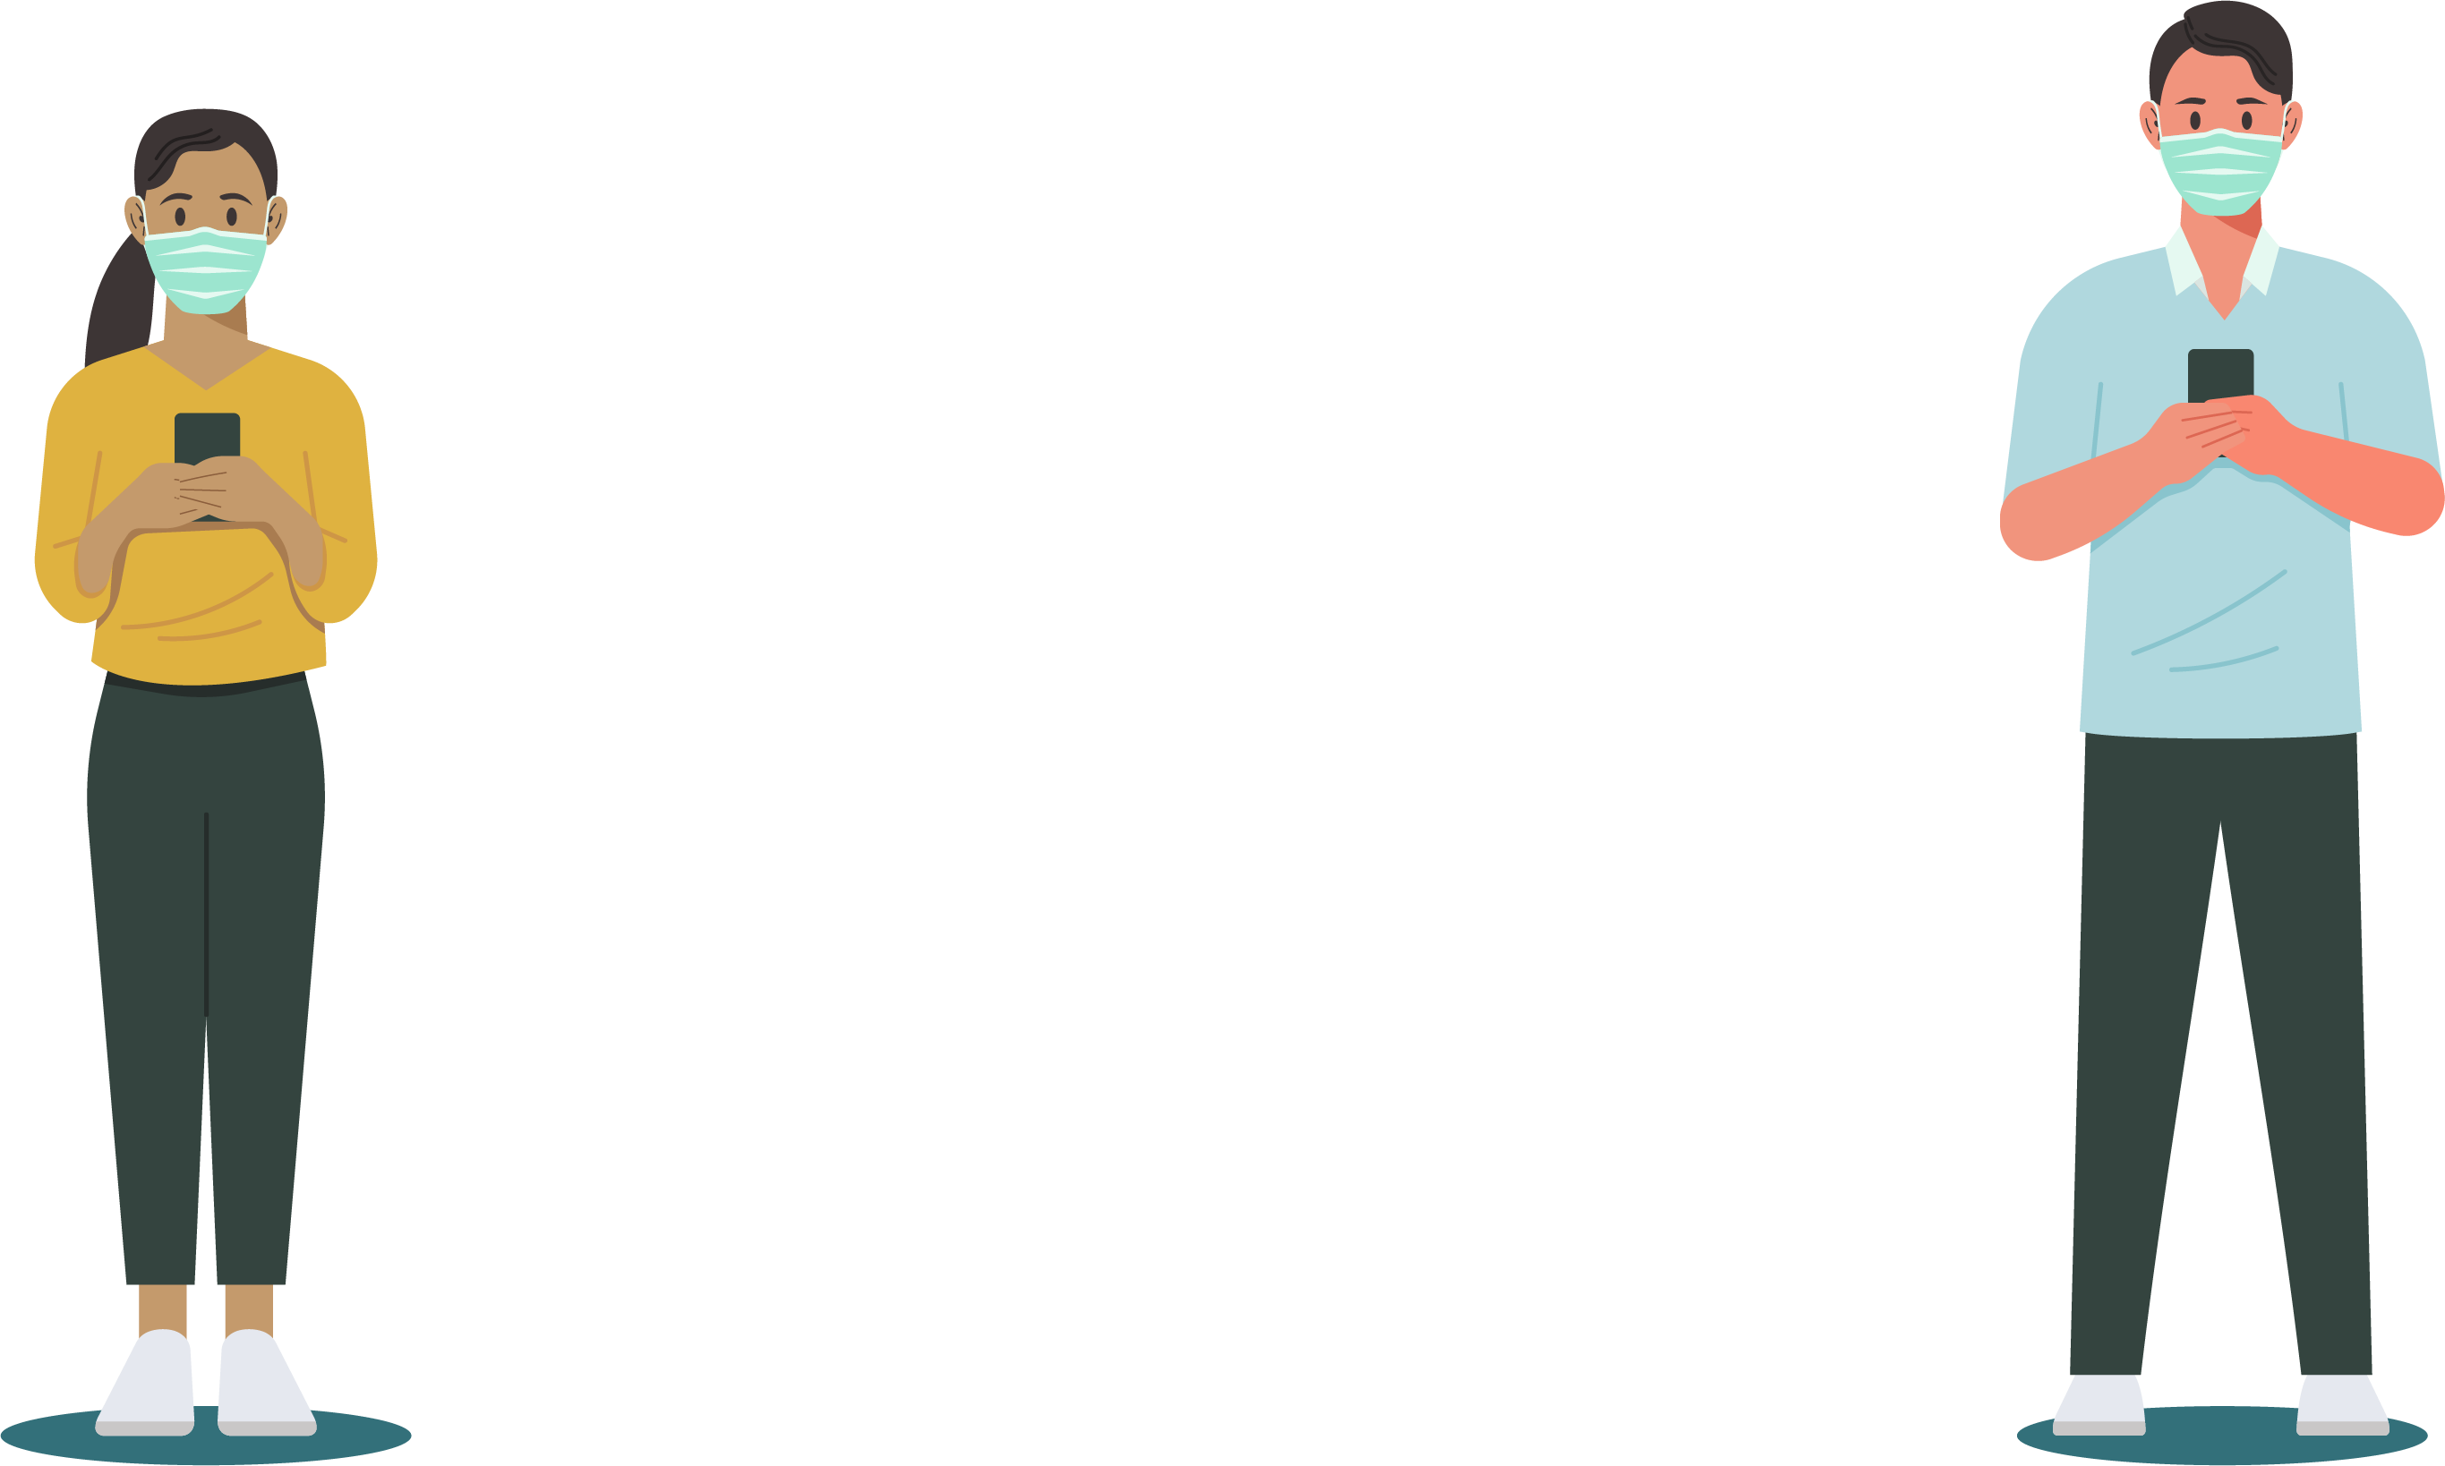
THANK YOU!
6 feet | 2 m

